Slide 1
July 21, 2021
U.S. & Wisconsin Construction Outlook:
Pandemic Impacts, Policy Initiatives, Project Implications
Ken Simonson
Chief Economist, AGC of America
ken.simonson@agc.org
©2021 The Associated General Contractors of America, Inc.

Slide 2
Total Nonfarm & Construction Employment, Feb. 2020-June 2021
cumulative change (seasonally adjusted)
Change to 6/21 from:
2/20
6/20
Residential Construction
1.7%
6.8%
Total Nonfarm
-4.4%
5.7%
Nonresidential Construction
-6.2%
1.0%
2/20
3/20
4/20
5/20
6/20
7/20
8/20
9/20
10/20
11/20
12/20
1/21
2/21
3/21
4/21
5/21
6/21
©2021 The Associated General Contractors of America, Inc.

Slide 3
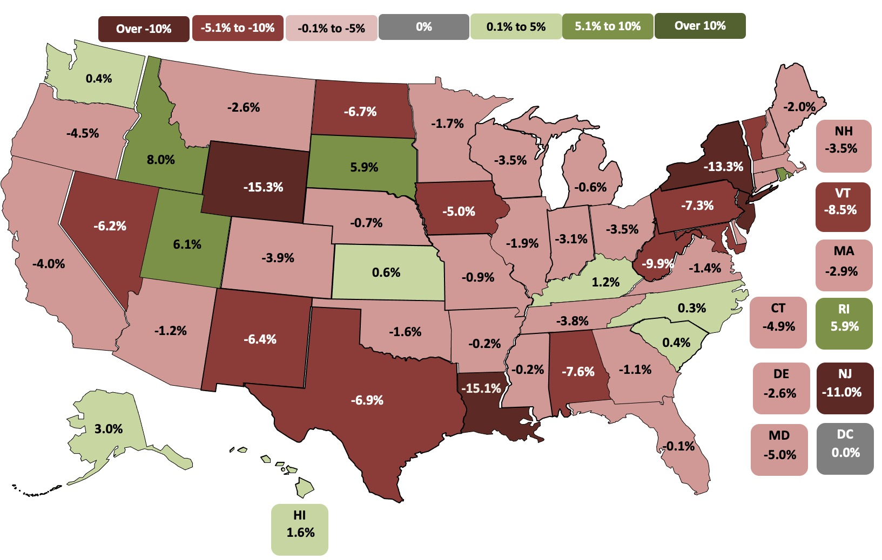
State construction employment change, Feb. 2020-June 2021
11 states up, 39 states down and DC flat (U.S.: -3.1%)
Top 5
Idaho | 8.0%
Utah | 6.1%
Rhode Island | 5.9%
South Dakota | 5.9%
Alaska | 3.0%
Bottom 5
Wyoming | -15.3%
Louisiana | -15.1%
New York | -13.3%
New Jersey | -11.0%
West Virginia | -9.9%
Note: Shading based on unrounded numbers Source: BLS state and regional employment report
©2021 The Associated General Contractors of America, Inc.

Slide 4
Illinois & Wisconsin Construction Employment
Cumulative change, Jan 2020-Jun 2021, seasonally adjusted
% change
Jan 2020-
Jun 2021:
IL
-2.5%
WI
-3.3%
1/20
2/20
3/20
4/20
5/20
6/20
7/20
8/20
9/20
10/20
11/20
12/20
1/21
2/21
3/21
4/21
5/21
6/21
Source: BLS
©2021 The Associated General Contractors of America, Inc.

Slide 5
Wisconsin Metro Area Construction Employment
January 2019–June 2021, not seasonally adjusted
Jun 2021 change from:
Jun 2021 change from:
Jun 2021 [32,500]
Jun 2019: -5.8%
Jun 2019: 3.1%
Jun 2020 [34,400]
Jun 2020: -5.5%
Jun 2020: 9.2%
Milwaukee-Waukesha-West Allis
Jun 2019: 3.0%
Jun 2019: -7.2%
Jun 2020: 6.3%
Jun 2020: 1.3%
Lake County-Kenosha County, IL-WI
Source: BLS *The Bureau of Labor Statistics reports employment for construction, mining and logging combined for metro areas in which mining and logging have few employers. Construction-only employment change is shown for a metro if BLS posts that data.
©2021 The Associated General Contractors of America, Inc.

Slide 6
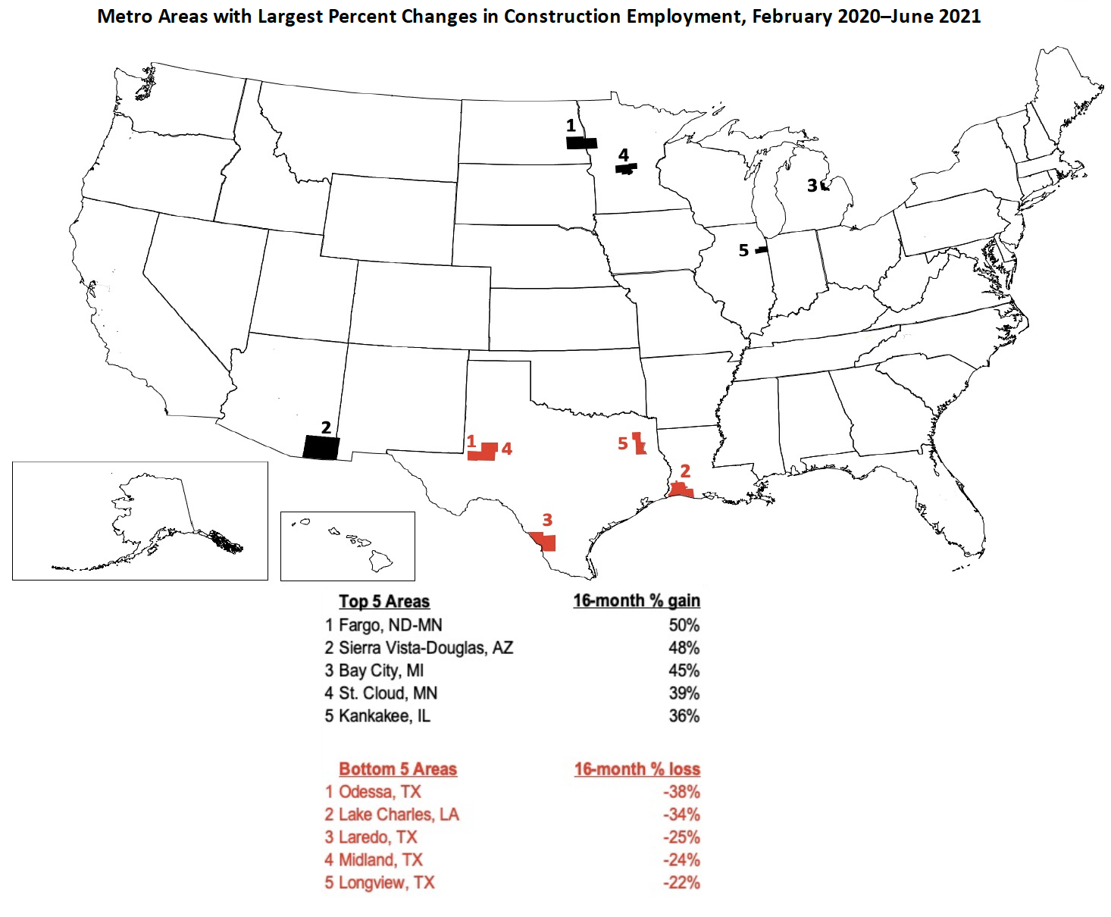
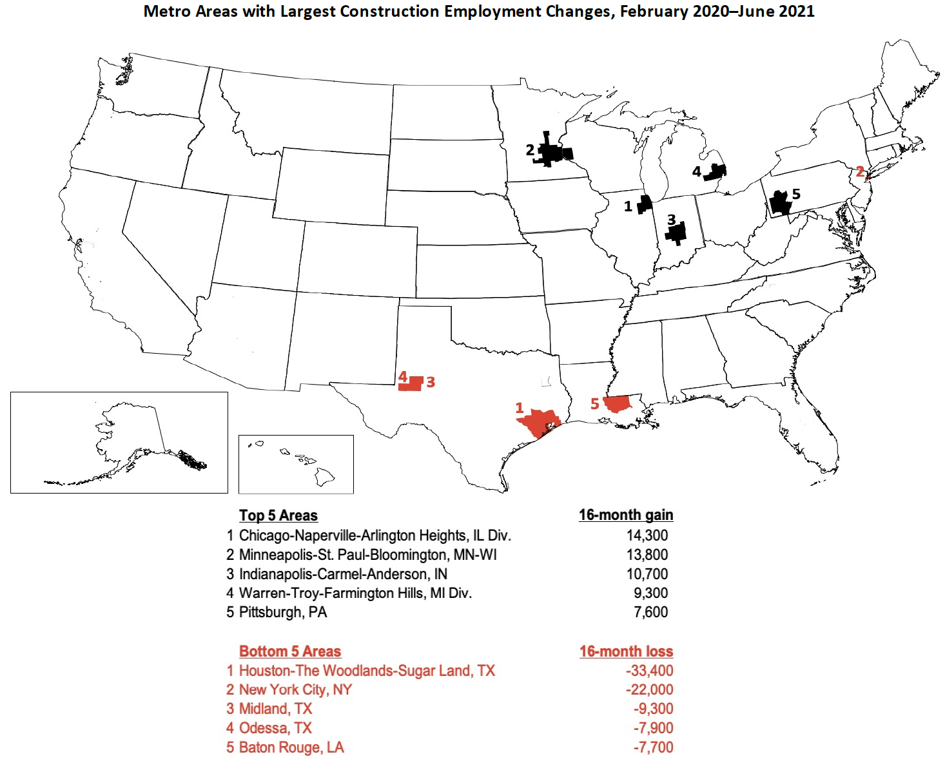
Metro construction employment change, Feb. 2020-June 2021
257 metros up, 21 metros unchanged, 80 metros down (U.S.: 4.3%)
Note: Shading based on unrounded numbers Source: BLS state and regional employment report
©2021 The Associated General Contractors of America, Inc.

Slide 7
Year-to-date construction spending: Jan-May 2021 vs. Jan-May 2020
(not seasonally adjusted)
Total 5%; private residential 24% (single-family 33%; multi 20%); private nonres -9%; public -7%
Largest segments (in descending order of 2021 year-to-date spending)
Power -7% (electric -4%; oil/gas fields & pipelines -16%)
Education -11% (primary/secondary -5%; higher ed -20%)
Commercial -6% (warehouse 8%; retail -22%)
Office -12%
Highway and street -6%
Mfg. -5% (chemical 6%; transp. equip. 3%; electronic -19%; food/beverage/tobacco 8%)
Transportation -7% (air -11%; freight rail/trucking -6%; mass transit 6%)
Health care -3% (hospital 2%; medical building -8%; special care -6%)
Lodging -27%
Source: Author
©2021 The Associated General Contractors of America, Inc.

Slide 8
Construction input and ‘bid price’ producer price indexes (PPIs)
cumulative change in PPIs, June 2020 -June 2021 (not seasonally adjusted)
Inputs to construction June 20-June 21: 26.3%
‘Bid price’ (new nonres building construction) June 20-June 21: 3.4%
6/20
7/20
8/20
9/20
10/20
11/20
12/20
1/21
2/21
3/21
4/21
5/21
6/21
Source: Bureau of Labor Statistics
©2021 The Associated General Contractors of America, Inc.

Slide 9
PPIs for construction and selected inputs
cumulative change in PPIs, June 2020 -June 2021 (not seasonally adjusted)
% change
June 2020-
June 2021:
Lumber and plywood
101%
Steel mill products
88%
Copper and brass mill shapes
61%
Aluminum mill shapes
33%
Plastic construction products
22%
Gypsum products
18%
‘Bid price’ (new nonres building construction)
3.4%
6/20
7/20
8/20
9/20
10/20
11/20
12/20
1/21
2/21
3/21
4/21
5/21
6/21
©2021 The Associated General Contractors of America, Inc.

Slide 10
Cost squeeze on contractors can last two years or more
Difference between year-over-year change in materials costs vs. bid prices, Jan 2006-June 2021
= period when change in costs exceeded change in bid price
2006
2007
2008
2009
2010
2011
2012
2013
2014
2015
2016
2017
2018
2019
2020
2021
Source: Bureau of Labor Statistics, producer price indexes for goods inputs to nonresidential construction (material costs) and
new warehouse construction (bid prices)

Slide 11
AGC’s responses to material cost
and supply-chain issues
Construction Inflation Alert: https://www.agc.org/sites/default/files/AGC 2021 Inflation Report_Version5_S_0.pdf
ConsensusDocs Price Escalation Resource Center: https://www.consensusdocs.org/price-escalation-clause/
Recording of webinar on “Soaring Material and Supply-Chain Costs and Delays”: https://store.agc.org/Store/CSI/Store/Product_List_WebEds.aspx
Presentations to government contracting officials and owner groups
Lobbying for tariff relief on lumber, steel, aluminum, and products
- Presentation to National Economic Council, VP’s chief economist, Commerce chief economist
- Presentations in coalitions to counselor to Commerce secretary, Senate & House trade staff
Source: Author
©2021 The Associated General Contractors of America, Inc.

Slide 12
Forward-looking indicators
Indicator | Latest date | Current value | Year-ago value
Architecture Billings Index (ABI) | June | 57.1 | 40.7
Dodge Momentum Index (DMI) | June | 166 | 118
Multifamily permits (year-to-date) | Jan-June | 250,700 | 207,500
Source: American Institute of Architects (ABI), Dodge Data & Analytics (DMI), Census Bureau (New Residential Construction)
©2021 The Associated General Contractors of America, Inc.

Slide 13
Medium-term impacts as recovery begins
Economic recovery looks more certain but virus risks remain
Slower rebound than for other sectors as owners, investors/lenders, institutions, and public agencies face uncertainty about future demand, project costs, and completion times
Best private prospects: remodeling, local distribution centers, data centers, restaurants
Less demand than pre-crisis for retail, offices, higher ed, lodging & travel-related
Less near-term demand for sports, entertainment, cultural facilities
Best public prospects: K-12 schools
Unclear how states and localities will spend added federal dollars
Additional federal highway funding likely; other infrastructure remains uncertain
Source: Author
©2021 The Associated General Contractors of America, Inc.

Slide 14
Long-run construction outlook (post-pandemic)
Slower population growth means slower demand growth for most construction
Permanent shift from retail to e-commerce/distribution structures
More specialized and online healthcare facilities; fewer hospitals, nursing homes
More wind, solar, battery storage and charging facilities, and related manufacturing
Less oil drilling, pipelines, gas stations, auto repair(?)
Continuing demand for K-12 but much less for higher ed construction
Not clear if offices will decentralize or remain in less demand
No sign of change yet in urban/rural or state-to-state trends
Source: Author
©2021 The Associated General Contractors of America, Inc.

Slide 15
Population change by state, July 2019–July 2020 (U.S.: 0.35%)
Decrease
0-0.49%
0.5-0.99%
1.0-1.49%
1.5%+
1.0%
2.1%
Top 5
ID | 2.1%
AZ | 1.8%
NV | 1.5%
UT | 1.5%
TX | 1.3%
1.0%
0.3%
0.6%
0.2%
0.3%
NH 0.4%
0.1%
-0.6%
VT
-0.1%
0.4%
0.6%
-0.2%
-0.2%
1.5%
0.1%
-0.1%
MA
-0.02%
1.5%
0.3%
-0.6%
-0.03%
0.9%
0.4%
-0.6%
0.04%
0.2%
0.4%
CT -0.3%
RI -0.1%
0.1%
Bottom 5
NY | -0.6%
IL | -0.6%
HI | -0.6%
WV | -0.6%
MS | -0.4%
1.8%
0.9%
0.3%
0.5%
0.8%
DE 1.0%
NJ -0.1%
1.3%
0.3%
1.2%
-0.4%
0.3%
0.8%
MD
0.01%
DC
0.6%
AK
-0.3%
-0.3%
1.1%
HI -0.6%
Source: U.S. Census Bureau, Dec. 2020 estimates (may change once decennial census data is included)
©2021 The Associated General Contractors of America, Inc.

Slide 16
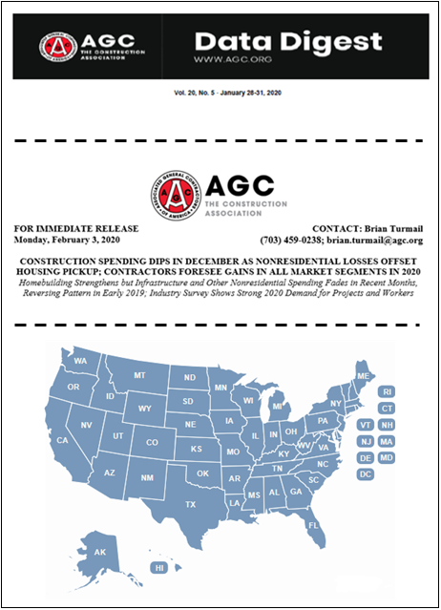
AGC economic resources
(email ken.simonson@agc.org)
The Data DIGest: weekly 1-page email (subscribe at http://store.agc.org)
Construction Inflation Alert:
https://www.agc.org/sites/default/files/AGC 2021 Inflation Report_Version5_S_0.pdf
ConsensusDocs Price Escalation Resource Center: https://www.consensusdocs.org/price-escalation-clause/
Surveys, state and metro data, fact sheets: www.agc.org/learn/construction-data
Monthly press releases: construction spending; producer price indexes; national, state, metro employment with rankings
Source: Author
©2021 The Associated General Contractors of America, Inc.

